Slide 1
std::variant and the power of pattern matching

Slide 2


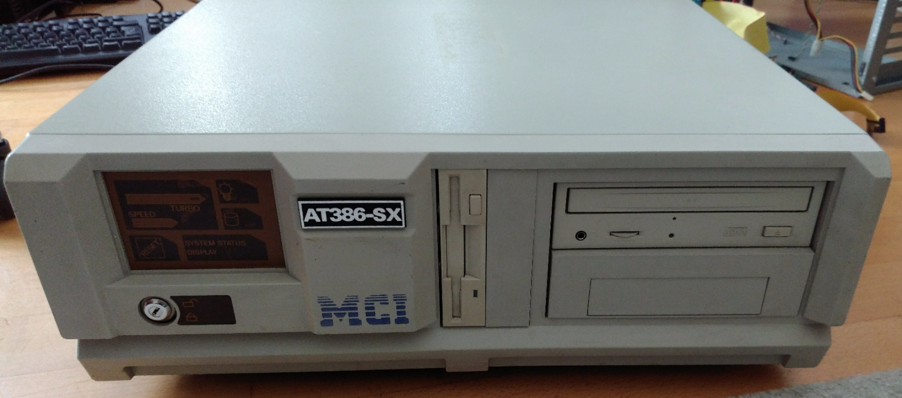
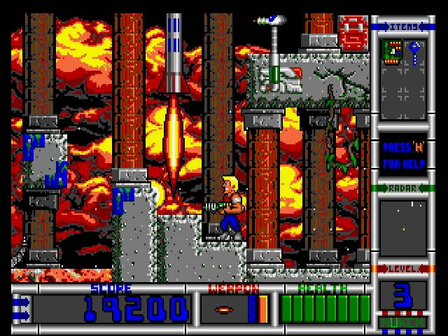
About Me
Tech Principal at Ableton
Making music hardware & software
Into: Games, guitar playing, vintage computers
Notes:
https://cdn.wccftech.com/wp-content/uploads/2016/11/Horizon-Zero-Dawn-Difficulty-Settings.jpg
https://image.dosgamesarchive.com/screenshots/duke2_009.png
Own photo
Own photo

Slide 3
Motivation

Slide 4
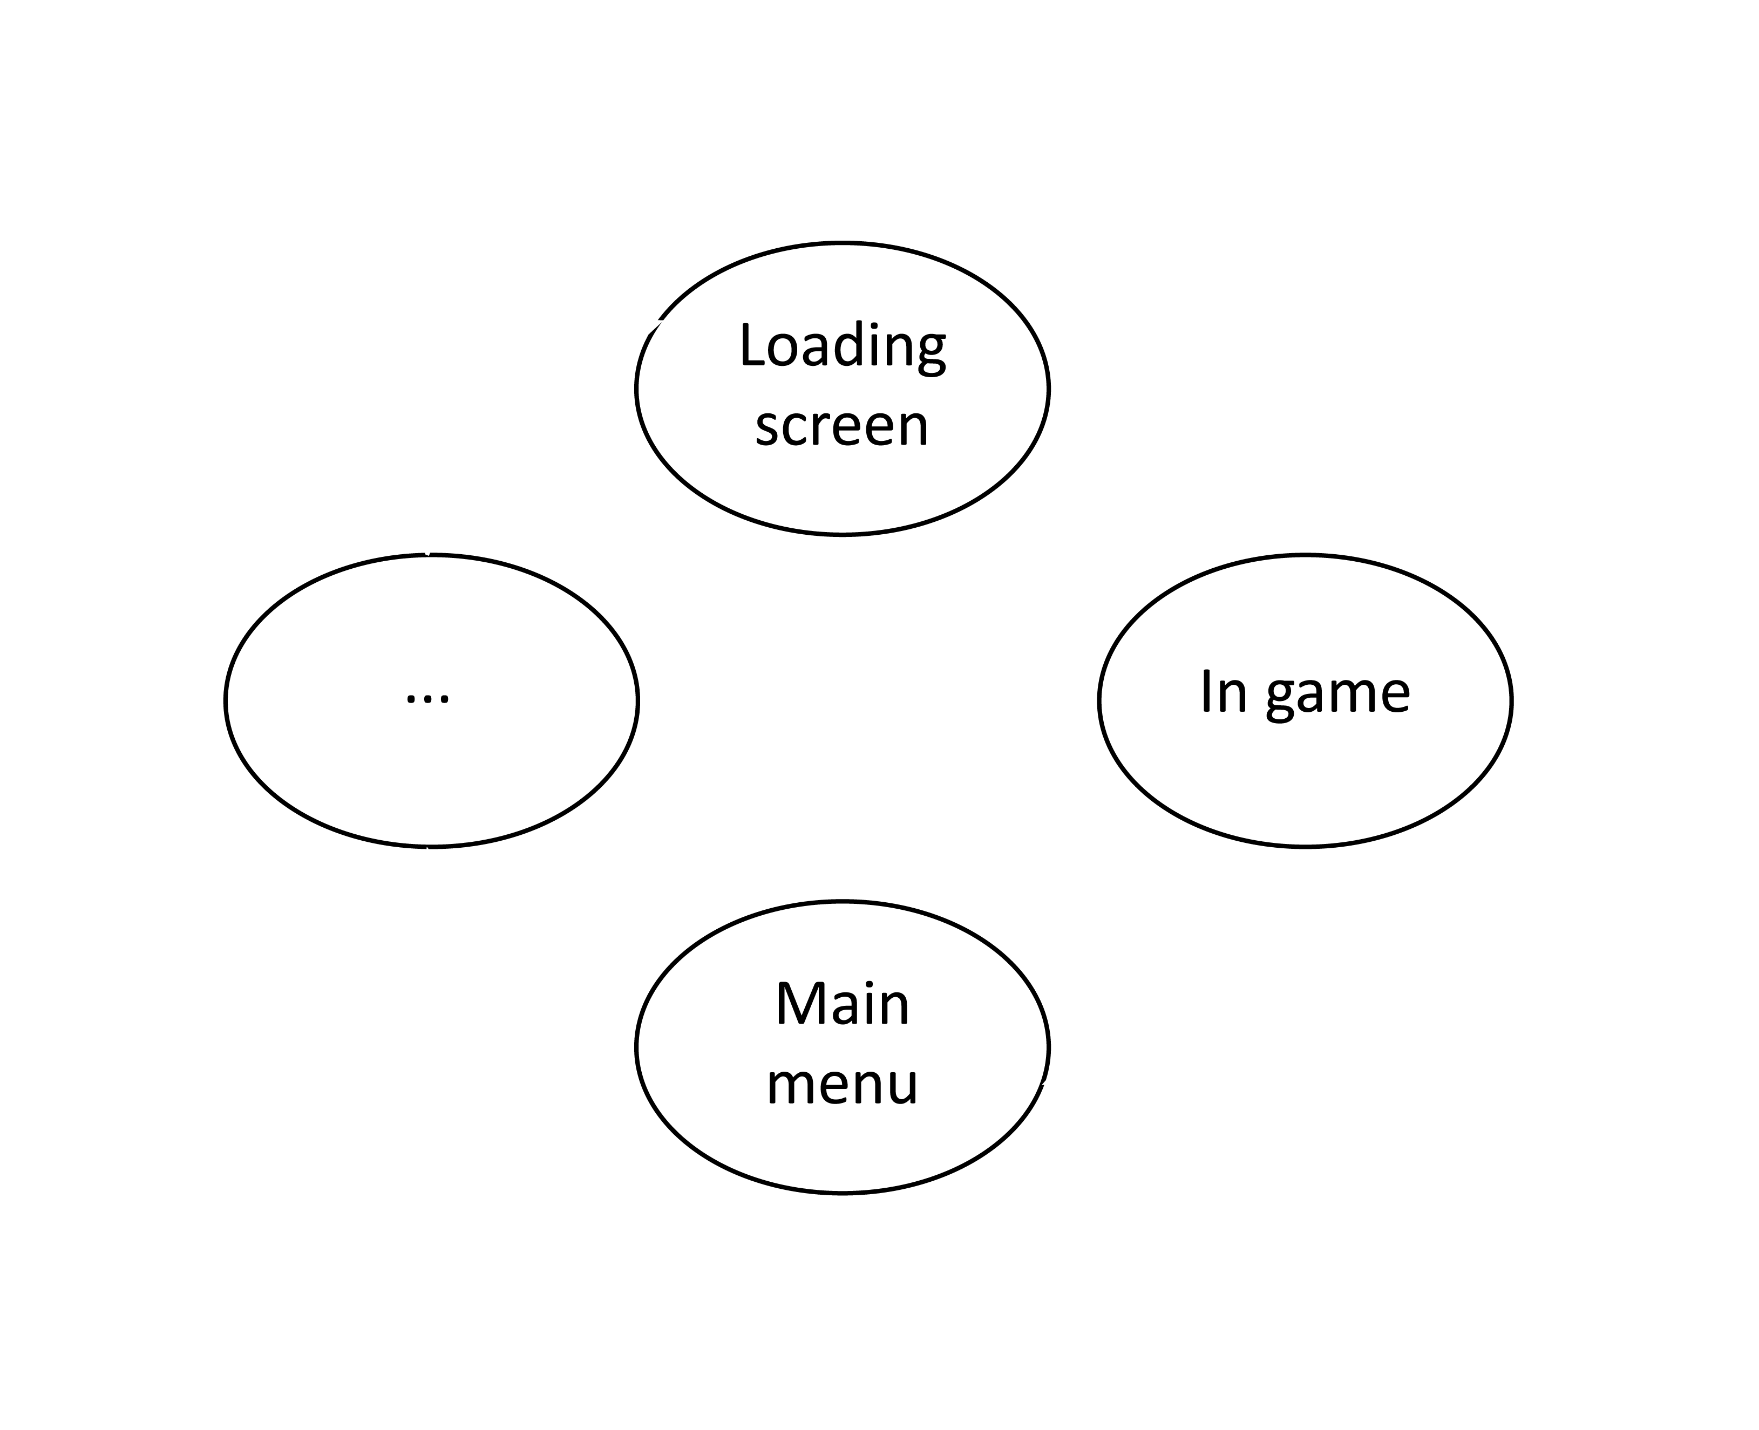
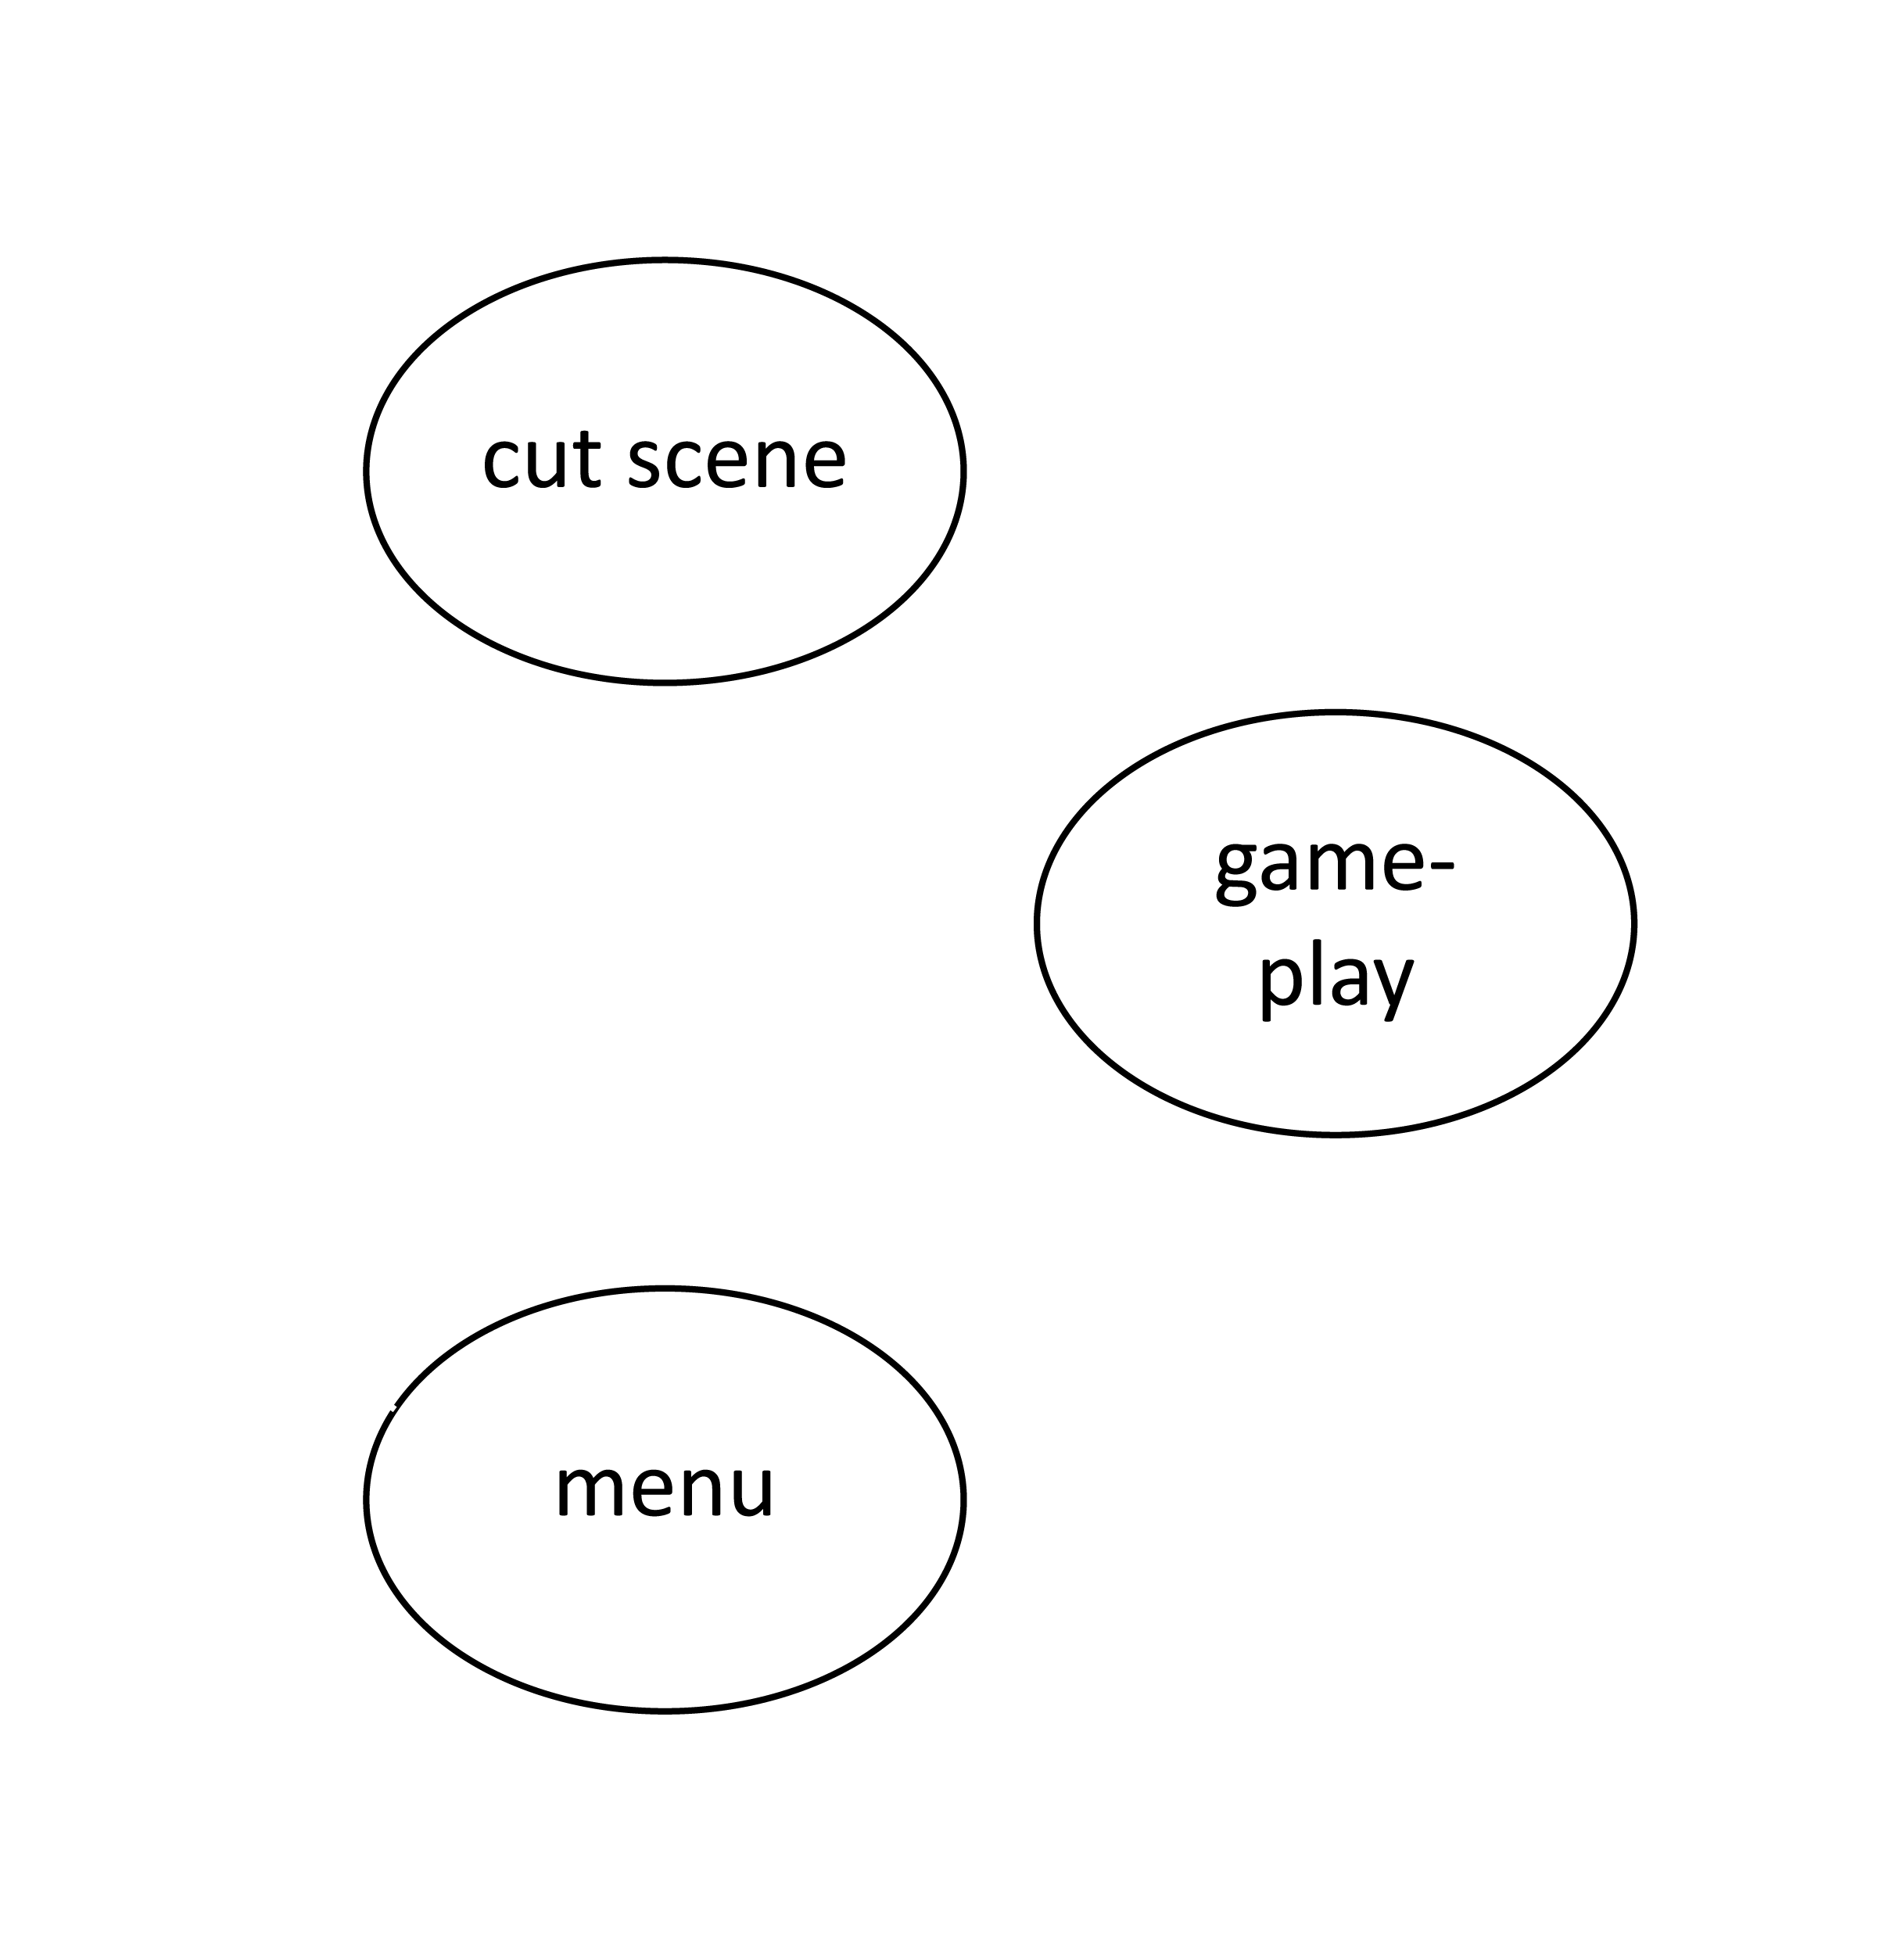
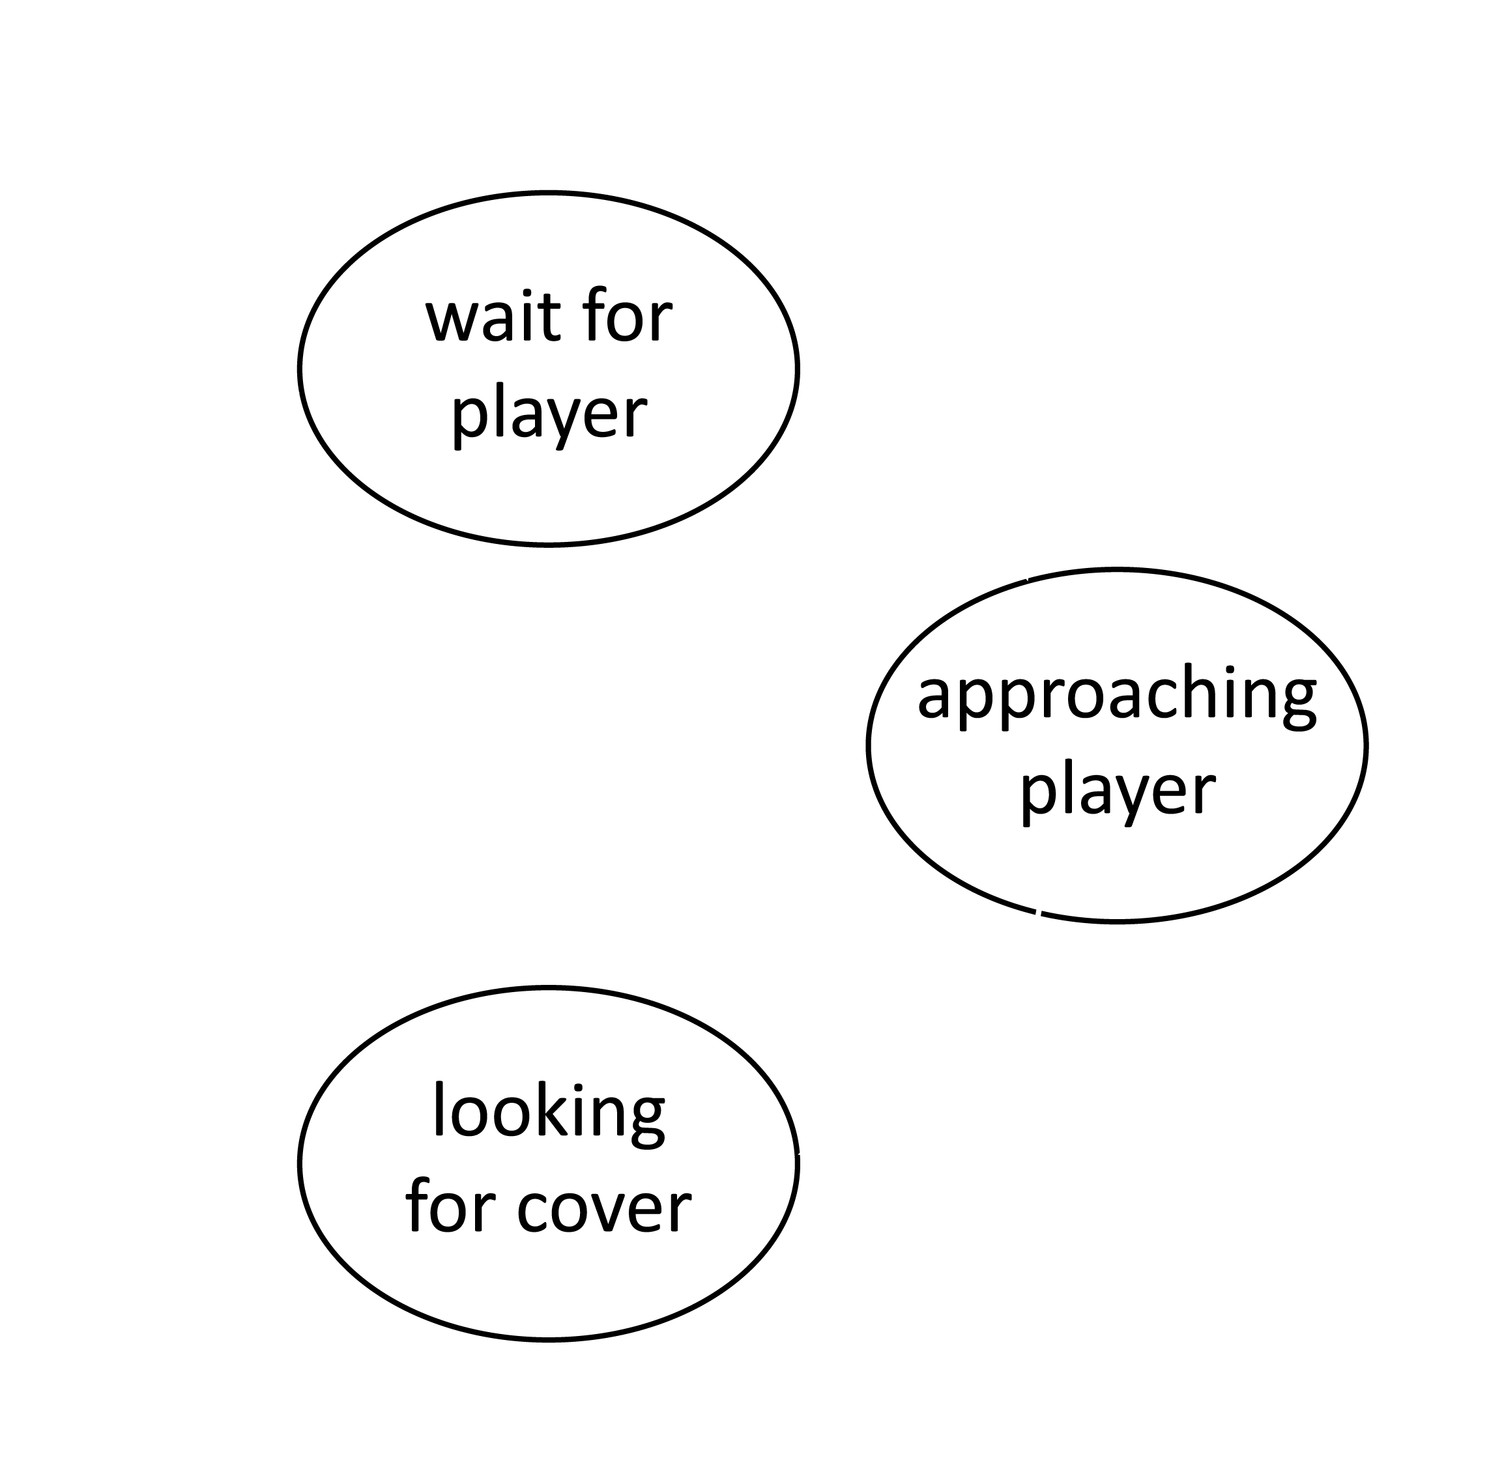
Notes:
Icon source: https://www.onlinewebfonts.com/icon/562659

Slide 5
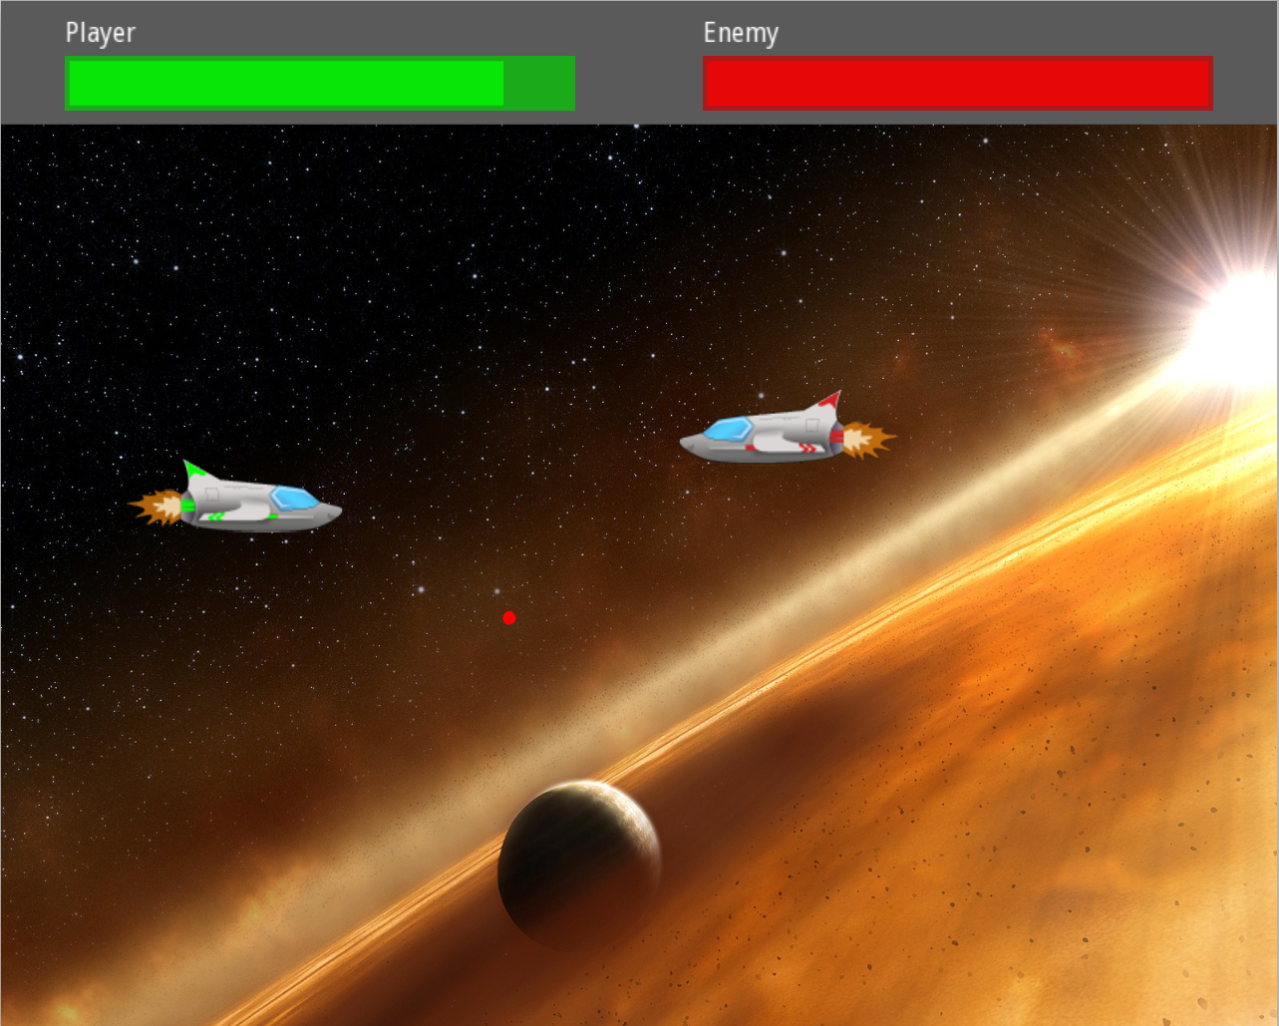
Notes:
DEMO!!!

Slide 6
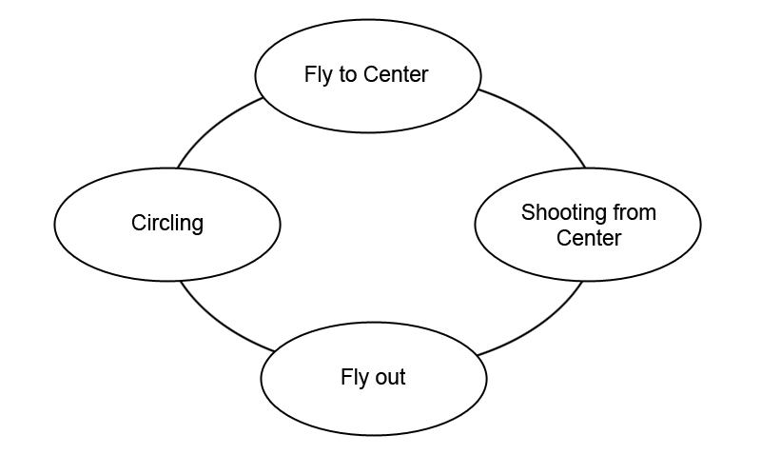
Space Game: Opponent state machine

Slide 7
Traditional: enum + state variables
struct Enemy {
enum class State {
Circling,
FlyToCenter,
ShootingFromCenter,
FlyOut
};
State state;
double timeSinceLastShot;
double timeSpentInCenter;
int nextCirclePosIndex;
};
switch (state) {
case S::Circling:
// ...
break;
case S::FlyToCenter:
// ...
break;
case S::ShootingFromCenter:
// ...
break;
// ...
}

Slide 8
Traditional: enum + state variables
struct Enemy {
enum class State {
Circling,
FlyToCenter,
ShootingFromCenter,
FlyOut
};
State state;
double timeSinceLastShot;
double timeSpentInCenter;
int nextCirclePosIndex;
};

Slide 9
Wanted: Modeling states explicitly
State
Circling
timeSinceLastShot
nextCirclePosIndex
ShootingFromCenter
timeSinceLastShot
timeSpentInCenter
FlyToCenter
FlyOut
Notes:
Objects to represent states, plus a way to perform the right logic corresponding to the currently active state

Slide 10
Definition: Sum Type
“a datatype which can be one of several types of things”
“Only one of the types can be in use at any one time”
en.wikipedia.org/wiki/Algebraic_data_type
en.wikipedia.org/wiki/Sum_type

Slide 11
Tagged Union
struct TaggedUnion
{
enum class Tag
{
Int,
Float,
// ...
};
union Value
{
int i;
float f;
// ...
};
Tag tag;
Value value;
};
switch (v.tag)
{
case TaggedUnion::Tag::Int:
// Do something with v.value.i
break;
case TaggedUnion::Tag::Float:
// Do something with v.value.f
break;
// etc.
}
Notes:
Aka discriminated union
Problems:
Have to manually keep tag and value in sync
Have to handle non-trivially constructible/destructible objects manually

Slide 12
std::variant

Slide 13
Variant in C++ 17
using Value = std::variant<int, float, std::string>;
auto v = Value{100};
auto v2 = Value{2.5f};
v2 = "Hello”;
std::vector<Value> values{1, 2.5f, "Hello"};

Slide 14
Getting at the current value
variant<int, float> v{2.5f};
if (holds_alternative<int>(v))
{
auto i = get<int>(v);
// do something with i
}
else if (holds_alternative<float>(v))
{
// etc.
}
variant<int, float> v{2.5f};
if (auto pi = get_if<int>(&v))
{
auto i = *pi;
// do something with i
}
else if (auto pf = get_if<float>(&v))
{
// etc.
}
⚠️ no exhaustiveness check
Notes:
So when you combine the two, you can construct an if/else chain to handle all possible cases.
One big disadvantage: Unhandled cases aren’t detected (e.g. adding a new case, forgetting to adjust the client code)

Slide 15
Using std::visit()
struct Visitor
{
void operator()(int i) {
// Do something with i
}
void operator()(float f) {
// Do something with f
}
// etc.
};
variant<int, float> var{2.5f};
visit(Visitor{}, var);
Notes:
This doesn’t compile if the visitor doesn’t handle all cases – perfect! But it’s very clunky, and requires a lot of boilerplate if we want to refer to things in the surrounding scope.

Slide 16
Pattern Matching

Slide 17
Definition
„Pattern matching is a mechanism for checking a value against a pattern. A successful match can also deconstruct a value into its constituent parts. It is a more powerful version of the switch statement [...] and it can likewise be used in place of a series of if/else statements.”
https://docs.scala-lang.org/tour/pattern-matching.html

Slide 18
Matching values
if (n == 5) {
// ...
} else if (n >= 6 && n <= 10) {
// ...
} else if (n < 0) {
// ...
} else {
// ...
}
match (n) {
5 => // ...,
[6..10] => // ...,
n if n < 0 => // n ...,
_ => // ...
}

Slide 19
Native pattern matching: Haskell (1)
int factorial(int n) {
if (n == 0) { return 1; }
return n * factorial(n - 1);
}
factorial :: Int -> Int
factorial 0 = 1
factorial n = n * factorial (n - 1)

Slide 20
Sum types & pattern matching
variant<Type1, Type2, Type3> variantValue;
match (variantValue) {
Type1 t1 => ...,
Type2 t2 => ...,
Type3 t3 => ...,
}

Slide 21
Native pattern matching: Haskell (2)
data Tree a = Leaf a | Node (Tree a) (Tree a)
countNodes :: Tree a -> Int
countNodes (Leaf a) = 0
countNodes (Node left right) = 1 + countNodes left + countNodes right

Slide 22
Native pattern matching: Rust
enum Message {
Quit,
ChangeColor(i32, i32, i32),
Move { x: i32, y: i32 },
Write(String),
}
fn process_message(msg: Message) {
match msg {
Message::Quit => quit(),
Message::ChangeColor(r, g, b) => change_color(r, g, b),
Message::Move { x: x, y: y } => move_cursor(x, y),
Message::Write(s) => println!("{}", s),
};
}

Slide 23
Wanted: Pattern matching a C++ variant
variant<int, float, ...> var{2.5f};
match(var) {
int i => {
// Do something with i
},
float f => {
// Do something with f
},
// etc.
}

Slide 24
overloaded helper
template <typename... Ts>
struct overloaded : Ts...
{
using Ts::operator()...;
};
template <typename... Ts>
overloaded(Ts...) -> overloaded<Ts...>;
variant<int, float> myVar{2.5f};
struct Visitor {
void operator()(int i) {}
void operator()(float f) {}
};
visit(Visitor{}, myVar);
variant<int, float> myVar{2.5f};
visit(overloaded{
[](int i) {},
[](float f) {}
}, myVar);
Code from cppreference.com (std::visit page)
Proposal to add std::overload: P0051

Slide 25
Writing a match() function
template<typename Variant, typename... Handlers
auto match(Variant&& v, Handlers&&... handlers)
{
return std::visit(
overloaded{std::forward<Handlers>(handlers)...},
std::forward<Variant>(v));
}

Slide 26
Using the match() function
variant<int, float, ...> var{2.5f};
match(var,
[](int i) {
// Do something with i
},
[](float f) {
// Do something with f
},
// etc.
);
variant<int, float, ...> var{2.5f};
match(var) {
int i => {
// Do something with i
},
float f => {
// Do something with f
},
// etc.
}
Notes:
Not far off from ”real” pattern matching – but: no destructuring, limited to variants..

Slide 27
C++ 11 & 14 support

Slide 28
Variant libraries
Boost.Variant (many differences to std version)
github.com/eggs-cpp/variant (close to std)
github.com/mpark/variant (based on libc++ std::variant impl)
Abseil Variant (equivalent to std)
…
Notes:
At Ableton, we have our own library „estd” which provides std library features from newer standards to older compilers, and we have an implementation of variant for C++ 11 and 14 in it.

Slide 29
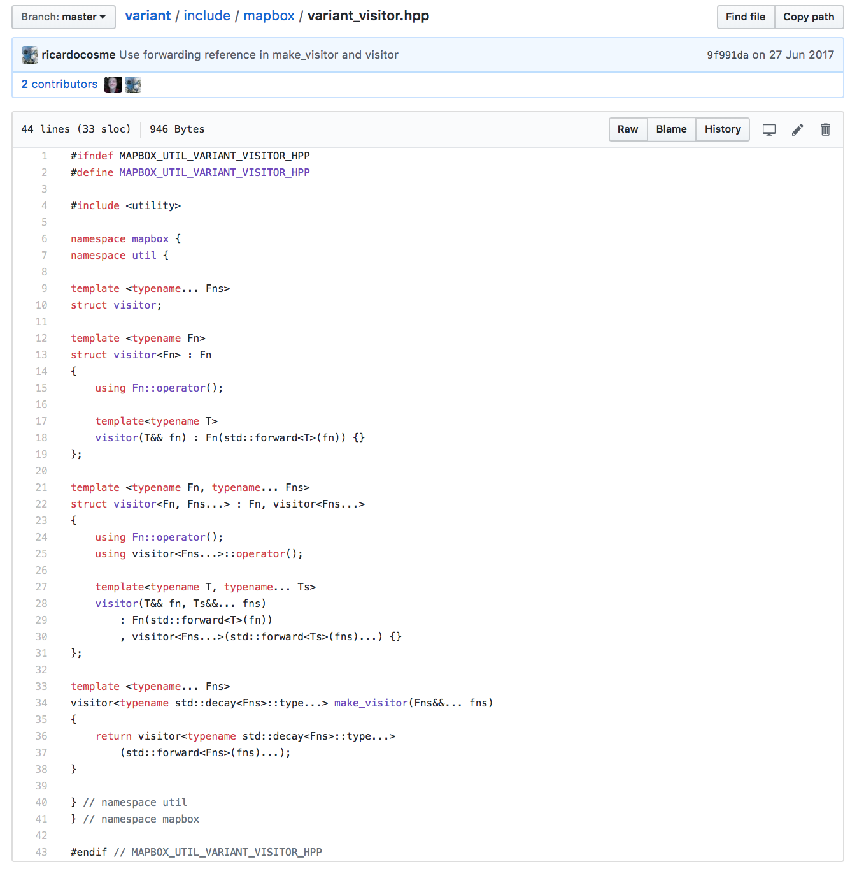
Match function
github.com/mapbox/variant → include/mapbox/variant_visitor.hpp
godbolt.org/z/rgaEpu

Slide 30
Examples
State Machines
Event Handling
More examples (brief)

Slide 31
1: State Machines

Slide 32
Reminder: Space game state machine

Slide 33
struct Circling {
double mTimeSinceLastShot = ENEMY_SHOT_DELAY;
int mNextCirclePosIndex = 0;
};
struct FlyToCenter { };
struct ShootingFromCenter {
double mTimeSinceLastShot = ENEMY_SHOT_DELAY;
double mTimeSpentInCenter = 0;
};
struct FlyOut {
int mTargetCornerIndex;
};
using State = std::variant<
Circling,
FlyToCenter,
ShootingFromCenter,
FlyOut>;

Slide 34
Implementing state-specific logic
class Enemy {
// ...
private:
State mState;
};
void Enemy::update() {
match(mState,
[](Circling& state) { /* ... */ },
[](const FlyToCenter&) { /* ... */ },
[](ShootingFromCenter& state) { /* ... */ },
[](const FlyOut& state) { /* ... */ }
);
}

Slide 35
State transitions: pitfall (1)
[=](const FlyToCenter& state)
{
if (reachedCurrentTarget)
{
mState = ShootingFromCenter{};
}
},

Slide 36
State transitions: pitfall (2)
[=](const FlyToCenter& state)
{
if (reachedCurrentTarget)
{
mState = ShootingFromCenter{};
}
if (state.mFoo ...) {
}
},
⚠️ undefined behavior!!

Slide 37
using MaybeNextState = std::optional<State>;
auto maybeNextState = match(mState,
// ...
[=](const FlyToCenter&) -> MaybeNextState {
if (reachedCurrentTarget) {
return State{ShootingFromCenter{}};
}
return std::nullopt;
},
// ...
);
if (maybeNextState) {
mState = *maybeNextState;
}

Slide 38
Evaluation

Slide 39
Comparison
Version | Compile time | Binary size | Binary (stripped) | Performance
Pattern matching | ~ 2.39 s | 45,364 B | 35,288 B | ~ 9 ns / iteration
State enum | ~ 2.19 s | 43,972 B | 35,288 B | ~ 6 ns / iteration
Difference | + 200 ms | + 1392 B | 0 B | + 3 ns
Core i5, 2 x 2.8 GHz (w/ Hyperthreading)
clang 7.0.0, release build (-O3)
2 translation units, compiled sequentially
measured using time utility
Notes:
No measurable impact on linking time.

Slide 40
Pro/Con
Pro
Guaranteed invariants
Exhaustiveness checking
Straightforward translation of conceptual model
Con
Needs adherence to “safe transition” pattern
No formalized separation between per-state behavior and state transitions

Slide 41
Recommendation
Use when:
Your logic can be organized as a state machine
Number of states and transitions is not too large

Slide 42
2: Event handling

Slide 43
Event handling
MouseClickEvent
x, y
button
KeyPressEvent
key code
isRepeat
WindowResizedEvent
width, height
ClientConnected
...
ConnectionInterrupted
...
Notes:
Why is event handling a good use case? You’ll typically distinguish between a variety of events (=switch on type), and each event will have associated data

Slide 44
Traditional approaches
Event ID plus untyped payload (Win32 API)
Tagged union (X11, SDL, SFML, ...)
Handler function per event type (Qt, GTK, Cocoa)
⚠️ type safety
boiler-plate code

Slide 45
Demo

Slide 46
enum class MouseButton {
Left,
Middle,
Right,
Unknown
};
struct MouseMoved {
int x = 0;
int y = 0;
};
struct MouseButtonDown { MouseButton button; };
struct MouseButtonUp { MouseButton button; };
struct WindowResized {
int newWidth = 0;
int newHeight = 0;
};
using Event = std::variant<
MouseMoved,
MouseButtonDown,
MouseButtonUp,
WindowResized>;

Slide 47
match(event,
[this](const MouseMoved& mouseMove) {
if (mShouldPrintMouseMoves) {
std::cout << "mouse moved to " << mouseMove.x << ", " << mouseMove.y << "\n";
}
},
[this](const MouseButtonDown& buttonDown) {
std::cout << "mouse button down (" << buttonDown.button << ")\n";
if (buttonDown.button == MouseButton::Right) {
mShouldPrintMouseMoves = !mShouldPrintMouseMoves;
std::cout << "\nprinting mouse moves: " << std::boolalpha << mShouldPrintMouseMoves << "\n\n";
}
},
[](const MouseButtonUp& buttonUp) {
std::cout << "mouse button up (" << buttonUp.button << ")\n";
},
[](const WindowResized& resized) {
std::cout << "window resized to " << resized.newWidth << ", " << resized.newHeight << "\n";
});

Slide 48
Evaluation

Slide 49
match(event,
[](const MouseMoved& m) {
// ...
},
[](const MouseButtonDown& b) {
// ...
},
[](const MouseButtonUp& b) {
// ...
},
[](const WindowResized& r) {
// ...
});
switch (event.type) {
case sf::Event::MouseMoved: {
const auto& m = event.mouseMove;
// ...
} break;
case sf::Event::MouseButtonPressed: {
const auto& b = event.mouseButton;
// ...
} break;
case sf::Event::MouseButtonReleased: {
const auto& b = event.mouseButton;
// ...
} break;
case sf::Event::Resized: {
const auto& r = event.size;
// ...
} break;
default:
break;
}

Slide 50
Comparison
Version | Compile time | Binary size | Binary (stripped) | Performance
Pattern matching | ~ 1.57 s | 22,048 B | 19,500 B | 29 ns / iteration
Tagged union | ~ 1.37 s | 19,652 B | 19,124 B | 28 ns / iteration
Difference | + 200 ms | + 2,396 B | + 376 B | + 1 ns
Core i5, 2 x 2.8 GHz (w/ Hyperthreading)
clang 7.0.0, release build (-O3)
2 translation units, compiled sequentially
measured using time utility
Notes:
No measurable impact on linking time.

Slide 51
Pro/Con
Pro
Type safety
Exhaustiveness checking
Conciseness
Con
Needs adaptation layer for existing libraries
Notes:
In my example, variant needs roughly 70 ms longer to compile compared to a tagged union

Slide 52
Recommendation
Use for:
Building your own platform abstraction library
Internal event handling
Notes:
If you’re using an existing platform abstraction layer, it’s probably not worth the effort to redefine and translate to your own events. But if you’re building your own platform abstraction library, consider using this approach for event handling.
Where it really shines in my opinion is “internal” event handling, i.e. events generated and consumed by your application logic.

Slide 53
More examples
Function return values
Scripting language OpCode dispatcher? → see GitHub repo
???
using IntersectResult = std::variant<Point, NoIntersection, Containment>;
IntersectResult testIntersection(const Ray& ray, const Plane& plane);

Slide 54
C++ Pattern Matching: Future

Slide 55
Beyond std::variant
https://github.com/mpark/patterns
#include <mpark/patterns.hpp>
void fizzbuzz() {
using namespace mpark::patterns;
for (int i = 1; i <= 100; ++i) {
match(i % 3, i % 5)(
pattern(0, 0) = [] { std::printf("fizzbuzz\n"); },
pattern(0, _) = [] { std::printf("fizz\n"); },
pattern(_, 0) = [] { std::printf("buzz\n"); },
pattern(_, _) = [i] { std::printf("%d\n", i); });
}
}

Slide 56
Native pattern matching proposal
Pattern matching: P1308
Language variants: P0095

Slide 57
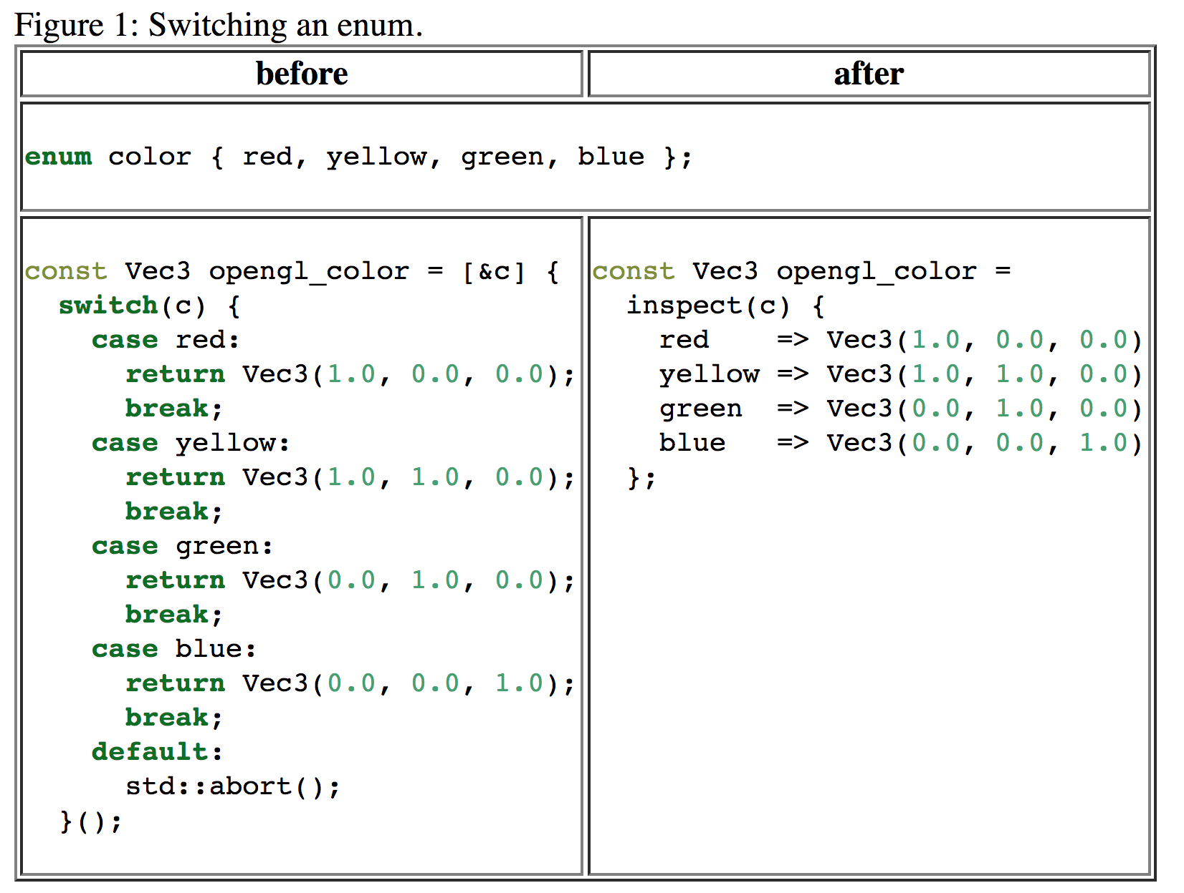

Slide 58
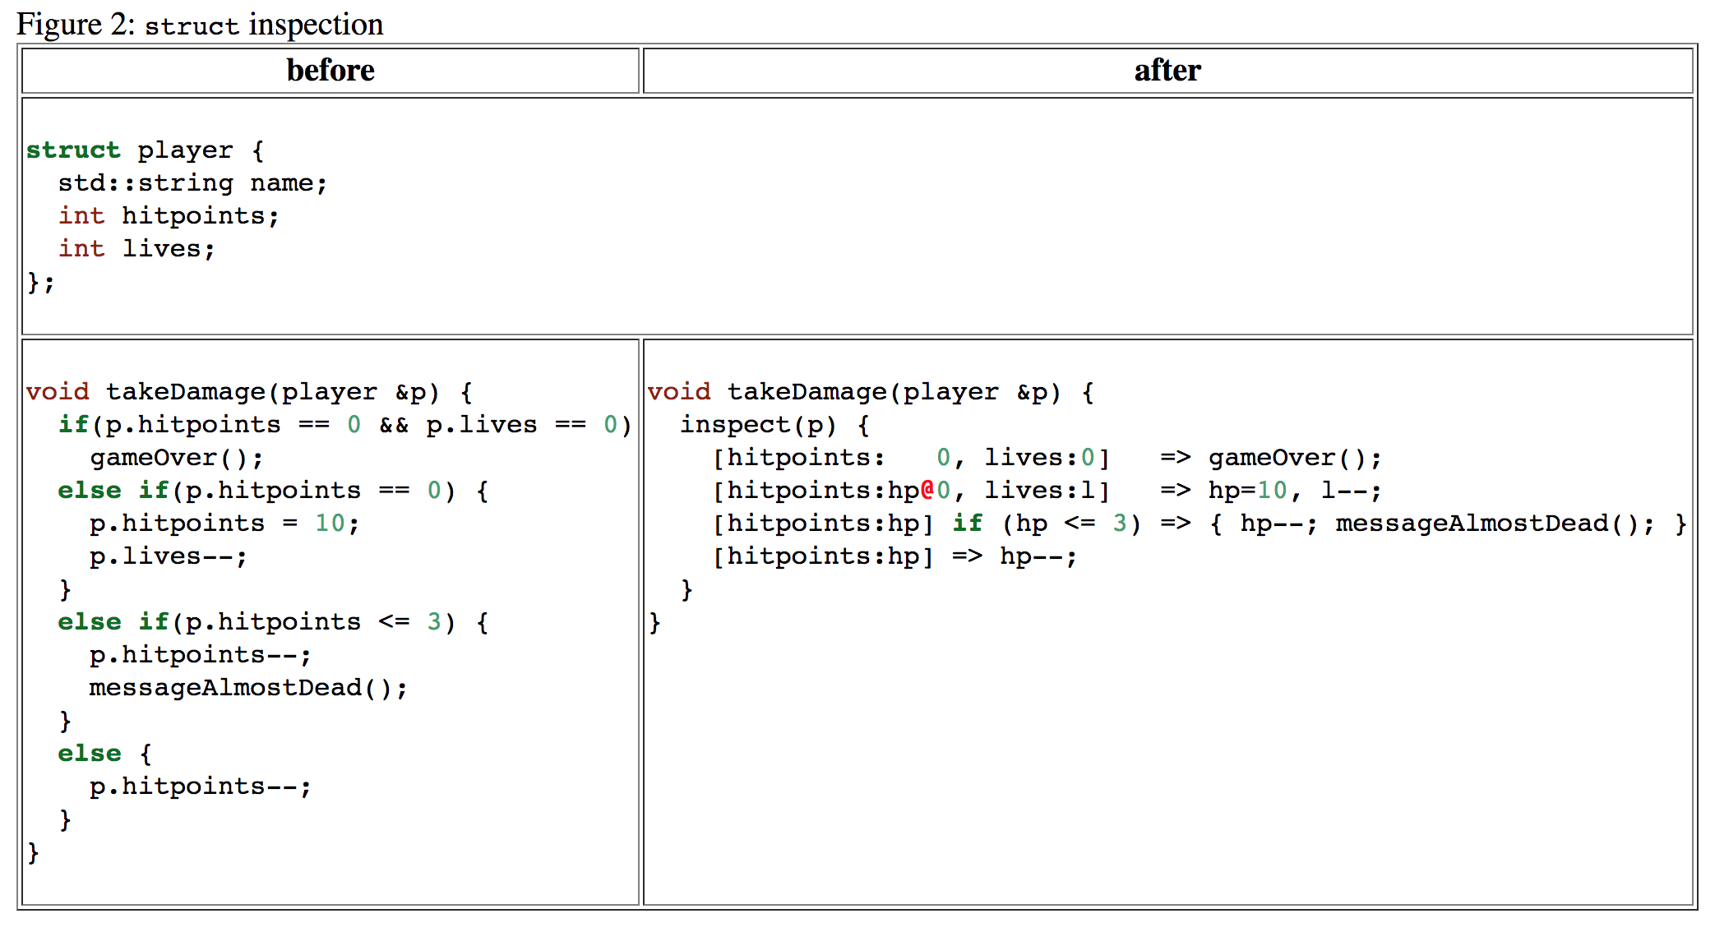

Slide 59
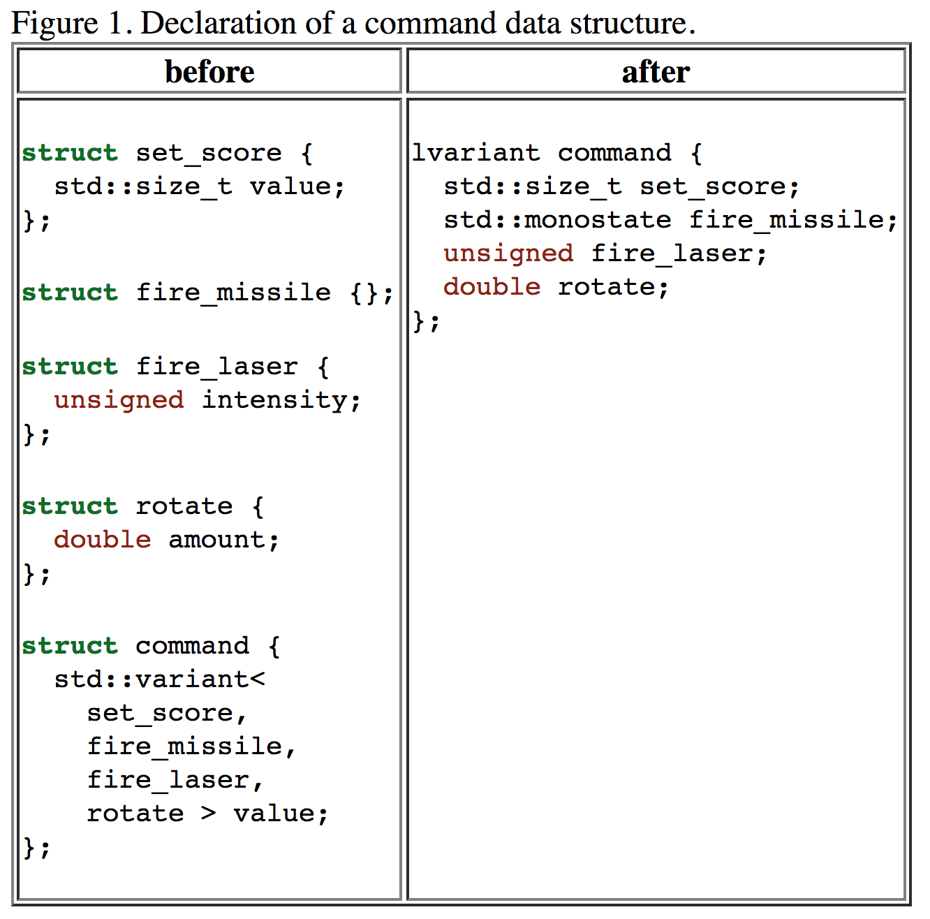

Slide 60
Summary and conclusion

Slide 61
Pattern matching today
Limited, but already useful
Many good use cases
Possible impact on compile time, binary size & performance
Harder to use for non-experts

Slide 62
Native pattern matching
Easier to use
Better performance (compile & run time)
More powerful! (destructuring, matching values etc.)

Slide 63

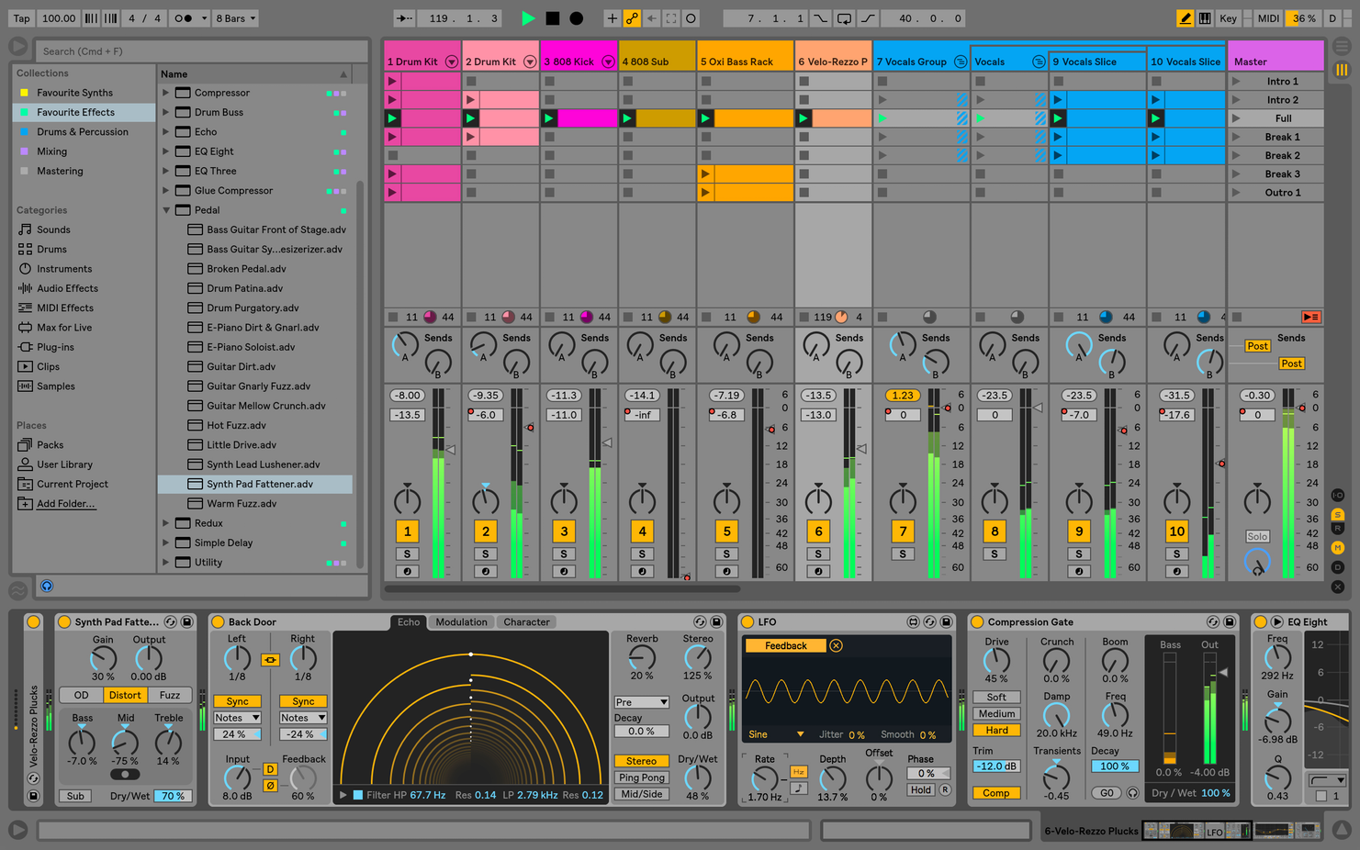
We are hiring!
github.com/lethal-guitar/VariantTalk
Look for „Software Engineer, Live“ at
meetingcpp.com/jobs
or
www.ableton.com/jobs

